Slide 1

Investigating Multi-Decadal Atmosphere & Ocean Variability
Jordan L Thomas
Thesis Presentation
February 20, 2018

Slide 2
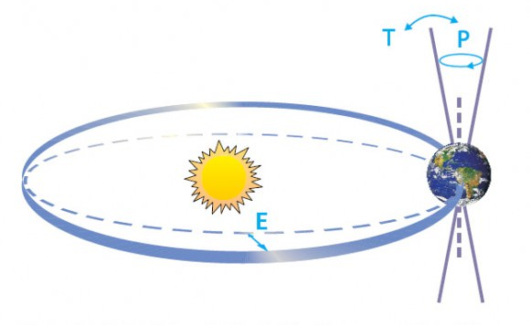

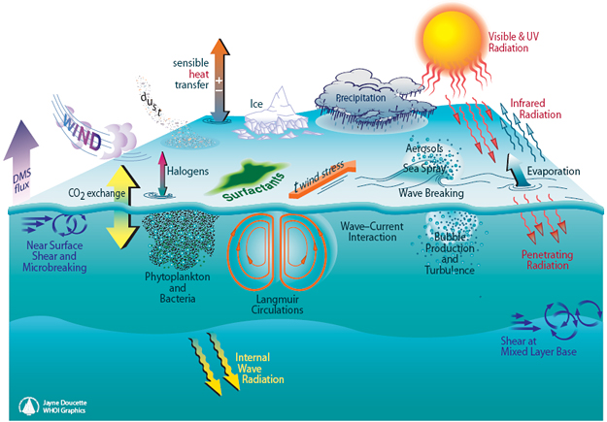


What causes global climate to change?
Internal Forcing
Natural Variability
External Forcing
Anthropogenic Forcing

Slide 3
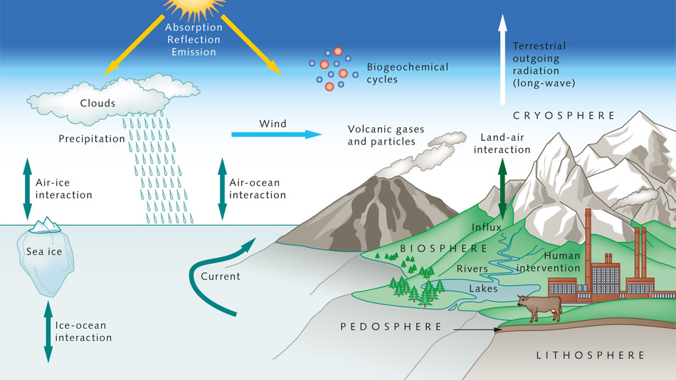

Slide 4
Why is Natural Variability Important?
Climate Predictability
How large does a trend need to be in order to detect it?
Projection Uncertainty
How much confidence should we have in climate projections?
Climate Model Evaluation
Do climate models have the correct magnitude and frequency of natural variability?

Slide 5
Thesis Aims:
Investigative look at the multi-decadal natural variability of three important components of the climate system:
Southern Hemisphere westerly jet
Oceanic carbon and heat content
North Atlantic oxygen and age

Slide 6
Presentation Outline
Introduction: Background and Methods
Part I: Southern Hemisphere Westerlies: Recent Trends and Natural Variability
Part II: Global Oceanic Heat and Carbon Content
Part III: Relationship between Ocean Age and Oxygen
Conclusions
Questions

Slide 7

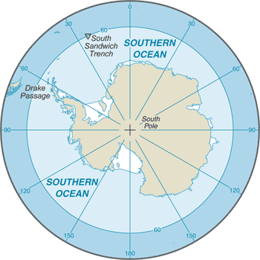

Slide 8
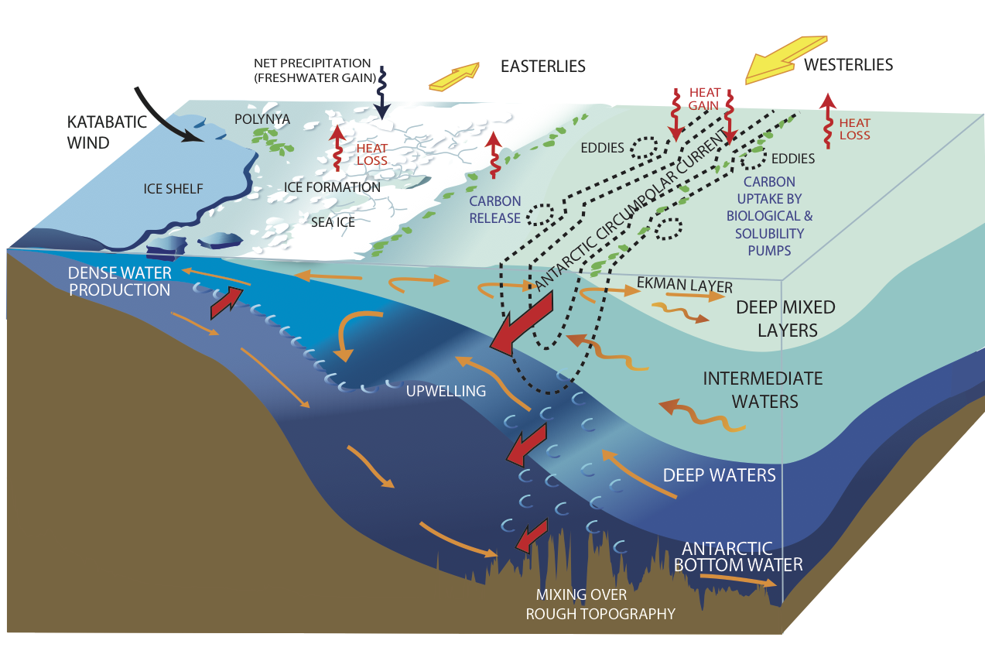
30% of anthropogenic carbon enters ocean south of 30S.
75% of heat enters ocean south of 30S
(Frolicher et al, 2015)

Slide 9
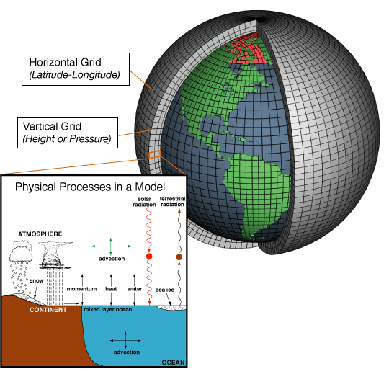
Climate Modeling
“All models are wrong, but some are useful” – George Box
Notes:
Climate models are systems of differential equations based on the basic laws of physics, fluid motion, and chemistry. To "run" a model, scientists divide the planet into a 3-dimensional grid, apply the basic equations, and evaluate the results. Atmospheric models calculate winds, heat transfer, radiation, relative humidity, and surface hydrology within each grid and evaluate interactions with neighboring points.

Slide 10
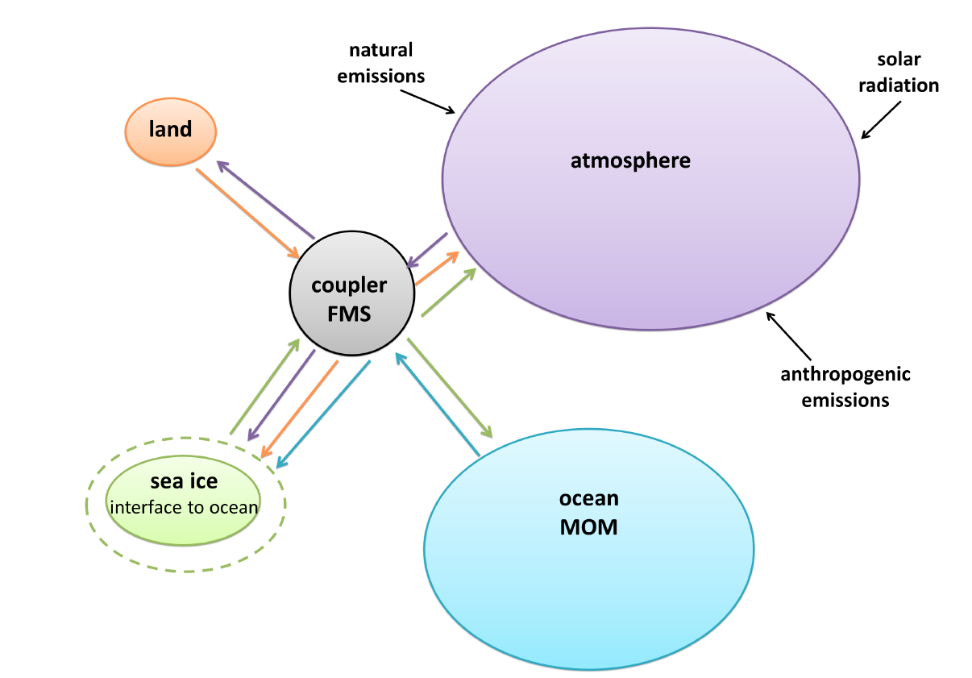
Climate Modeling
1. Pre-industrial Control Simulation
(“piControl”)
No anthropogenic forcing
2. Historical Simulation
Simulation of recent past
Historical (1850-2005) anthropogenic
forcing.
~ 400,000 Lines of Code

Slide 11
Two Types of Climate Simulations
Initialized using observations of temperature, salinity, and nutrients
(preindustrial GHG and aerosols)
Run for 1500 years
Steady State
Run additional years with pre-industrial forcing
Run 1850-2005 with historical greenhouse gases, ozone depletion, ect.
Pre-Industrial Control Simulation
Historical Simulation

Slide 12
Part I: Recent trends and natural variability in the Southern Hemisphere extratropical circulation
Thomas et al., 2016. Southern Hemisphere extratropical circulation: Recent trends and natural variability. Geophysical Research Letters. Vol. 42 5508-5515.

Slide 13
`

Slide 14
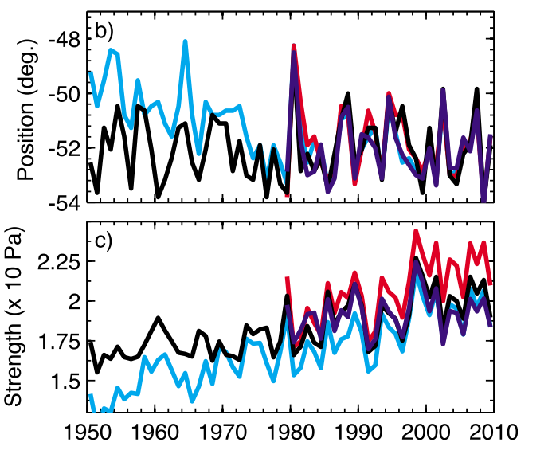
Recent Trends in the SH Westerly Jet
Multiple studies document an observed Strengthening and Pole-ward shift of the SH Westerly Jet^{1,2,3}.
Attributed to both Ozone Depletion^{4,5,6} and possibly Greenhouse Gas Induced Warming^{7,8,9}
Swart and Fyfe, 2012

Slide 15
Aims:
How large is the modeled natural variability?
Can the observed trend be captured in the modeled natural variability?

Slide 16

Climate Models Used
CMIP5 models
Coupled Model Inter-comparison Project.
20 modeling groups.
Intergovernmental Panel on Climate Change (IPCC) Report

Slide 17
Reanalysis Observations*
-2 Degrees/35 years

Slide 18
Natural Variability
Pre-industrial control model runs.
No anthropogenic forcing.
Run for 200-1000 years.

Slide 19
Natural Variability

Slide 20
Natural Variability

Slide 21
Natural Variability vs. Observations

Slide 22
Natural Variability vs. Observations
Model | R1 U_{loc}
CanESM2 | 4.18%
CNRM CM5 | 1.19%
GFDL ESM2M | 3.38%
IPSL CM5a LR | 7.92%
IPSL CM5a MR | 5.00%
IPSL CM5b LR | 9.30%
MIROC ESM | 1.13%
MIROC ESM CHEM | 3.39%
MIROC 5 | 0.38%
MPI ESM LR | 6.64%
MPI ESM MR | 6.22%
MRI CGCM3 | 2.87%
NOR ESM1m M | 1.38%
NOR ESM1m ME | 1.38%

Slide 23
Natural Variability vs. Observations
Model | R1 U_{loc}
CanESM2 | 4.18%
CNRM CM5 | 1.19%
GFDL ESM2M | 3.38%
IPSL CM5a LR | 7.92%
IPSL CM5a MR | 5.00%
IPSL CM5b LR | 9.30%
MIROC ESM | 1.13%
MIROC ESM CHEM | 3.39%
MIROC 5 | 0.38%
MPI ESM LR | 6.64%
MPI ESM MR | 6.22%
MRI CGCM3 | 2.87%
NOR ESM1m M | 1.38%
NOR ESM1m ME | 1.38%
Model | R1 U_{loc}
CanESM2 | 4.18%
CNRM CM5 | 1.19%
GFDL ESM2M | 3.38%
IPSL CM5a LR | 7.92%
IPSL CM5a MR | 5.00%
IPSL CM5b LR | 9.30%
MIROC ESM | 1.13%
MIROC ESM CHEM | 3.39%
MIROC 5 | 0.38%
MPI ESM LR | 6.64%
MPI ESM MR | 6.22%
MRI CGCM3 | 2.87%
NOR ESM1m M | 1.38%
NOR ESM1m ME | 1.38%

Slide 24
Natural Variability Results
The observed trend in jet location can be explained by natural variability alone.
Obs. Trend = Natural Variability + External Forcing
Are these observed trends in jet location anthropogenically forced?

Slide 25
Obs. Trend = Natural Variability + External Forcing

Slide 26
Conclusions
The CMIP5 historical model runs do not do a very good job at capturing the observed poleward shift in the SH Westerly Jet.
Due to the fact that the decadal-scale natural variability in jet location is large.
Observed trends within natural variability of the CMIP5 models.
Evidence that the jet latitude in the historical runs is being influenced by anthropogenic activity.

Slide 27
Part II: Relationship between ocean carbon and heat multi-decadal variability
Thomas et al., 2018. Relationship between ocean carbon and heat multi-decadal variability. Journal of Climate. Vol. 31 1467-1482.

Slide 28
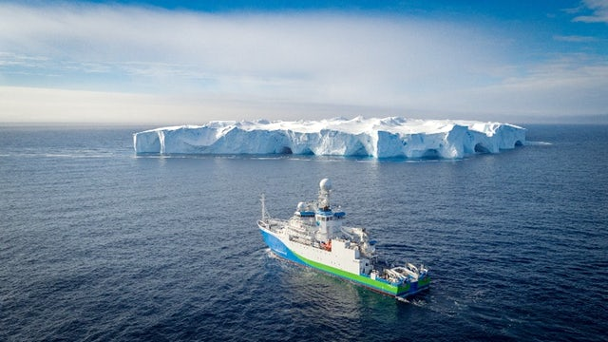
Oceanic Heat and Carbon Content
30% of anthropogenic carbon
75% of anthropogenic heat

Slide 29
Oceanic Heat and Carbon Content
Most: Impact anthropogenic forcing has
on oceanic uptake of carbon and
heat uptake and storage.
Few: Natural variability of oceanic heat
and carbon on decadal-centennial
timescales.
None: Examine carbon and heat variability
together.

Slide 30
Aims:
Investigate natural variability of both heat and carbon content in multiple simulations of an Earth system model
Examine the magnitude and frequency of the variability in global heat and carbon content in simulations with various mesoscale mixing parameter settings
Mechanisms that drive oceanic heat and carbon variability

Slide 31
Single Climate Model
GFDL ESM2Mc
Coarse-resolution version of GFDL ESM2M
4 simulations using different mesoscale mixing parameters

Slide 32
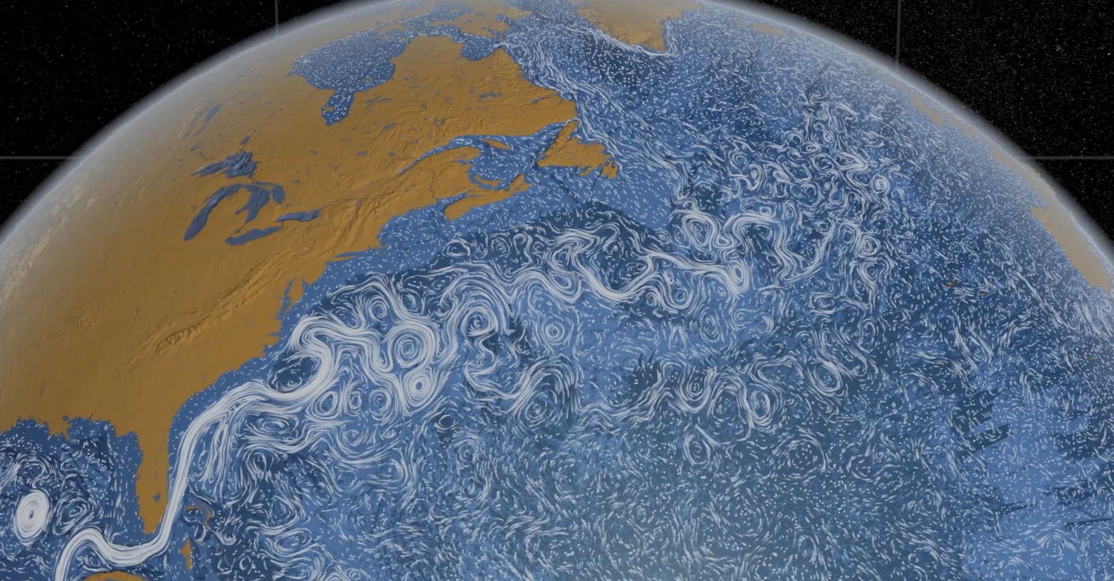
Mesoscale Eddies

Slide 33
Mesoscale Eddy Parameterizations
Eddy Advection: Flatten isopycnals
depth
, where S is the isopycnal slope
Constant density
(isopycnal)
Spatially and temporally varying (min 200 m²s⁻¹, max 1400 m²s⁻¹)
Eddy Diffusion: Mixes along isopycnals
, where is the lateral tracer gradient
depth
Constant density
(isopycnal)
Default = 800 m²s⁻¹

Slide 34
Model Simulations
Initialized using observations of temperature, salinity, and nutrients
(preindustrial GHG and aerosols)
Run for 1500 years
Steady State
A_{redi} = 400 m²s⁻¹
A_{redi} = 800 m²s⁻¹
A_{redi} = 2400 m²s⁻¹
A_{GM} min = 600 m²s⁻¹
Low Eddy Diffusion
Control
High Eddy Diffusion
High Eddy Advection

Slide 35
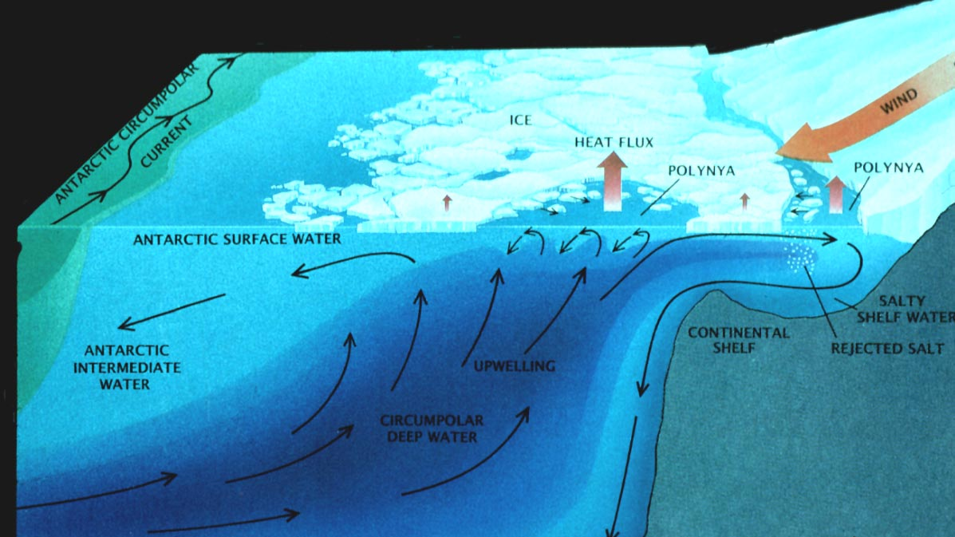
Weddell Polynya

Slide 36
Weddell Sea Deep Convection
Has not been observed since the 1970’s
Ubiquitous in climate models

Slide 37
Changing the mesoscale mixing has a large impact on Weddell Sea Deep Convection
Identify the impact convective variability has on both carbon and heat in the Southern Ocean and Globally
Oscillate between convective and non-convective
Always convecting
No convection

Slide 38
Global carbon content and global heat content for the control simulation
4% of anthropogenic
Variability is closely linked to Weddell Sea Convection
25% of anthropogenic
Anti-correlation between global heat and carbon content
(r = -0.629)

Slide 39
Global carbon content (solid) and global heat content (red).
r = -0.629
r = -0.496
r = -0.350
r = -0.452
Magnitude and frequency changes across simulations
Stronger correlation for simulations which oscillate between convective states
Mechanism driving anti-correlation is not dependent on convection

Slide 40
Convective Composite:
Subsurface quantities averaged over 10 convective years (shown as an anomaly)
Strong depletion in high latitude subsurface temperature and carbon convection
Strong surface warming throughout Southern Hemisphere
Increase in subsurface carbon in mid-latitudes
Decrease in tropical carbon

Slide 41
Preformed vs Remineralized DIC
DIC = DIC_{pre} + DIC_{remin}
Preformed DIC
DIC concentration of a parcel of water when last in contact with the surface
Remineralized DIC
DIC concentration due to biological accumulation

Slide 43
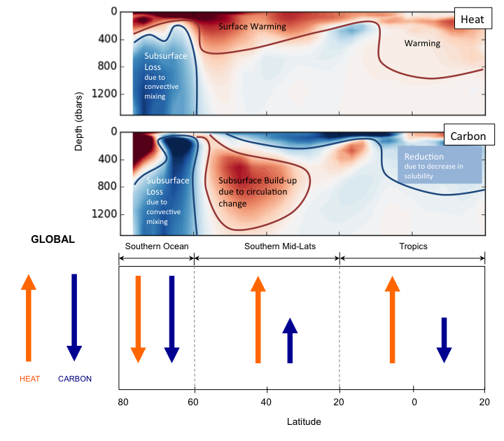

Slide 44
Conclusions
Magnitude and frequency of global carbon and heat content variability is heavily influenced by Weddell Sea convective variability.
Robust anti-correlation between global heat and carbon content.
Global carbon content driven by Southern Ocean variability with a cancelation between Southern mid-latitudes and tropics.
Global heat - cancelation between Southern Ocean and Southern mid-latitude/tropical variability.

Slide 45
Part III: Relationship between North Atlantic Oxygen and Age
Thomas et al., in prep. Investigating the relationship between age and oxygen on observational Line W.

Slide 46
North Atlantic Ocean

Slide 47
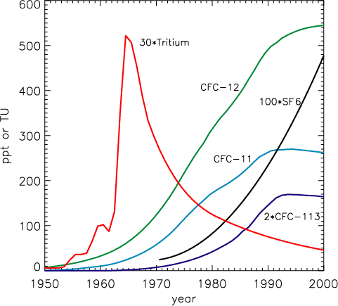
Ocean Age:
Age generally refers to a tracer that contains some measure of time since the water was last at the surface.
In observational data, age is calculated using transient tracers.
Through mathematical manipulation, you can calculate the mean age.

Slide 48
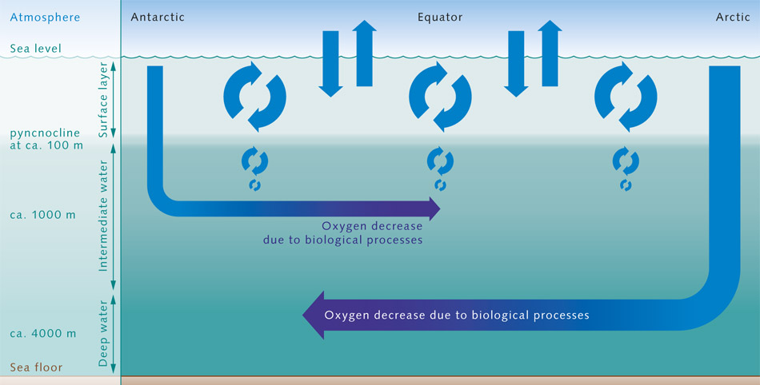
Ocean Oxygen

Slide 49
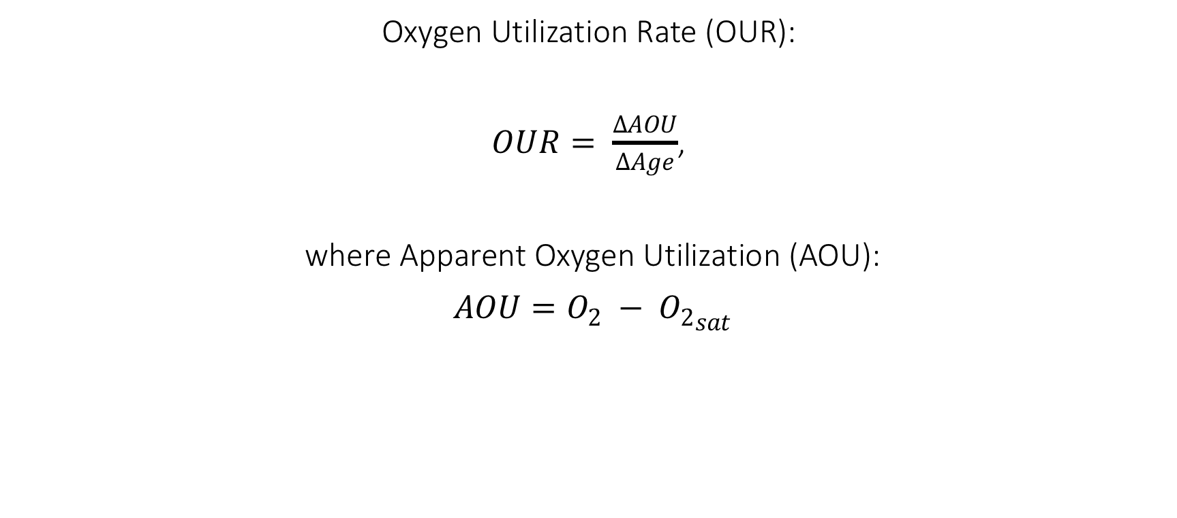
Age and Oxygen
Oxygen Utilization Rate (OUR):
$OUR= \frac{∆AOU}{∆Age}$,
where Apparent Oxygen Utilization (AOU):
$AOU=O_{2} − {O_{2}}_{sat}$
The Definition of OUR has been used extensively to:
Draw conclusions on organic matter transport from the surface ocean to the deep
Quantify biological productivity in the ocean

Slide 50
Age and Oxygen
Oxygen observations are far more common than CFC measurements
Difficulties calculating age from CFC measurements
Idea has been proposed that changes in oxygen could be used as a proxy for changes in age.

Slide 51
Aims:
Use recent observational data to evaluate the temporal relationship between age and oxygen.
Are the assumptions valid along observational Line W?

Slide 52
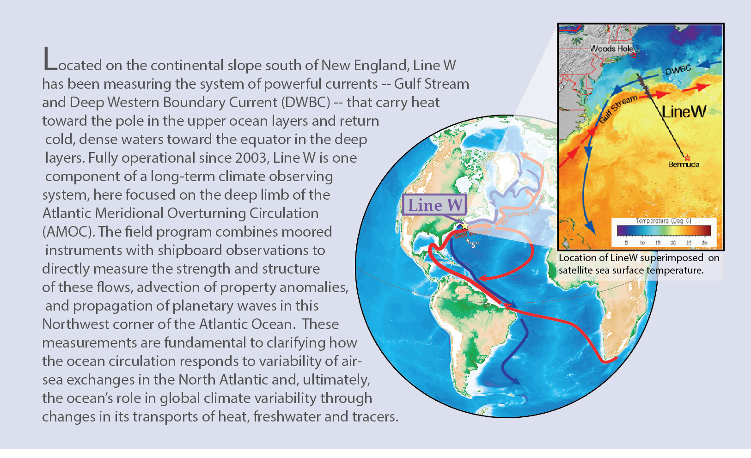
Observational Data – Line W
http://www.whoi.edu/science/PO/linew/index.php

Slide 53
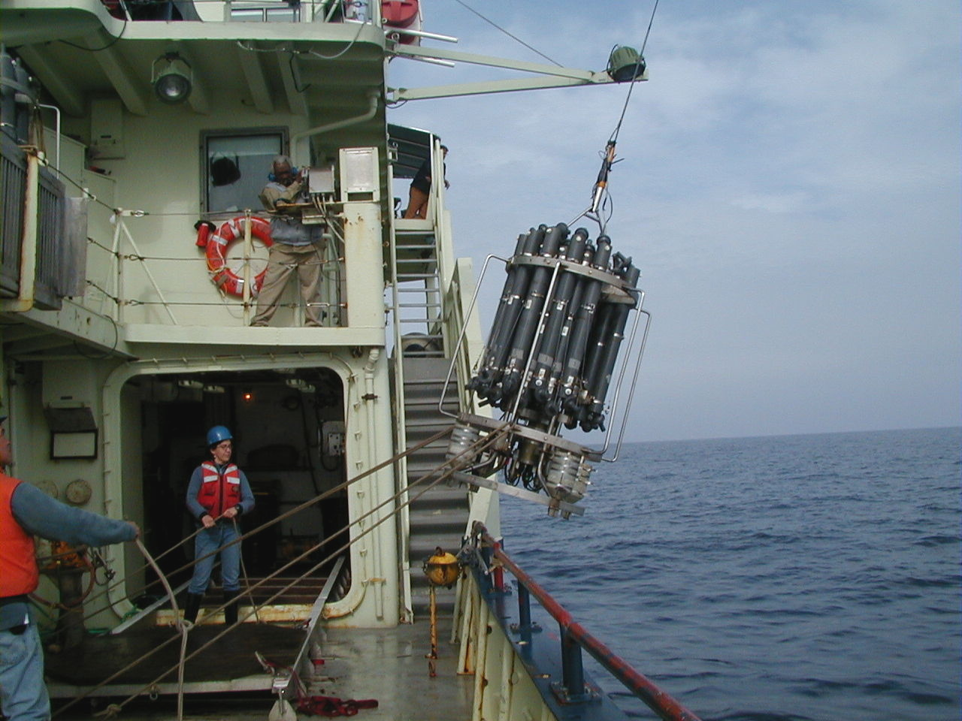
Sample Collection
CTD (Conductivity, Temperature, Depth) Rosette
Fitted with 27 sampling bottles
Image courtesy of WHOI

Slide 54
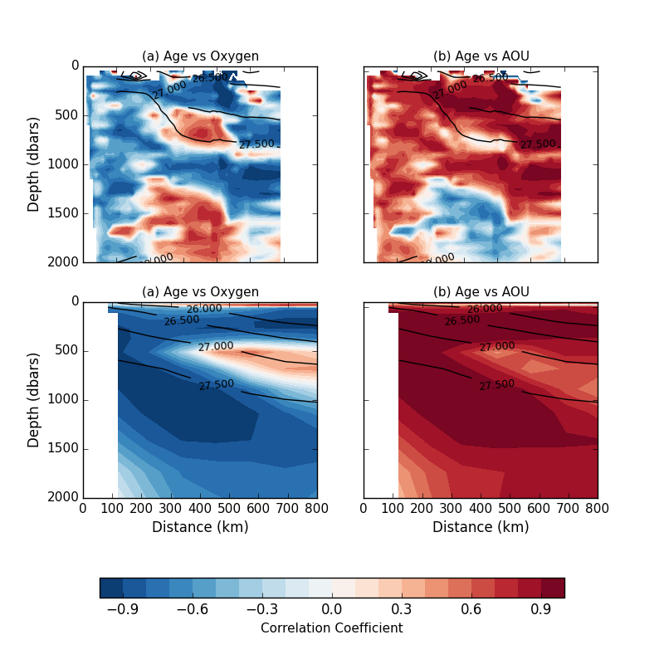
Age-Oxygen Correlation
Apparent Oxygen Utilization
AOU = O_{2 sat} – O₂
Observations:
Two regions of anomalous correlation
Model:
Upper region of anomalous correlation

Slide 55
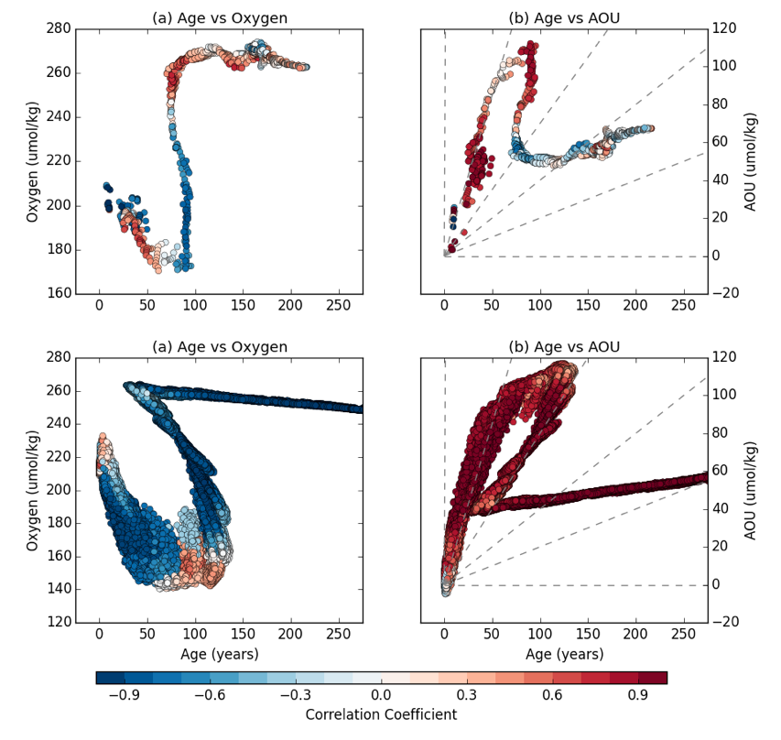
Age-Oxygen Scatterplot
“S-Shape” roughly follows depth
Dashed lines represent expected
linear relationships between age and AOU
Notes:
If the variability in AOU were driven exclusively by changes in the rate of ventilation
(but not the pathways of ventilation or the rate of remineralization), we would expect the
age-AOU relationship to fall along one of the dashed lines. The upper region does follow
this linear relationship (with a slope of 1.7mol yr􀀀1). When the age-AOU relationship
does not follow these linear lines however, it indicates that other processes are influencing
the spatial (and thus potentially the temporal) variability in AOU. The right-hand tail of
this relationship, where the correlation is negative, does not follow the anticipated linear
relationship, and therefore we can infer that some additional process is influencing the
AOU-age relationship.

Slide 56
Spatial Extent of Anomalous Correlation
Largely positive throughout the entire domain
Pearson correlation coefficients exceeding 0.6 in most
of the basin
Reduced correlation region isolated to deeper depths at the end of Line W.

Slide 57
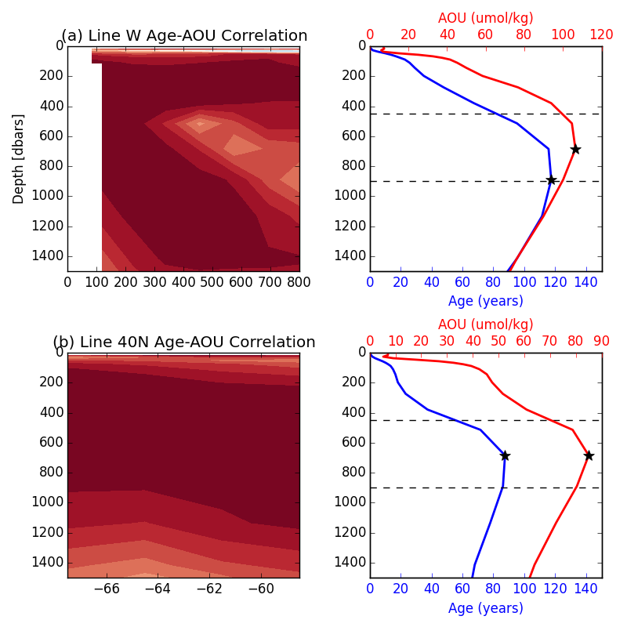
Line W versus “Line 40N”
Along Line W:
Depth offset between the age and AOU maximums.
Line 40N:
No depth offset
Any vertical motion would act to reduce the positive correlation.
AOU
Age
Depth

Slide 58
Vertical + Horizontal Variability
Horizontal (along-isopycnal) variability is very low at the end of Line W
Combination of low horizontal variability and depth offset of AOU and age maximum that causes anomalous correlation.

Slide 59
Conclusions
Observations and model data indicate age-oxygen correlation is more complicated than typically assumed.
Two regions of anomalous correlation seen in Line W observational data.
Analysis suggests anomalous correlation is due to both offset of age and AOU maximums and reduced horizontal variability.

Slide 60
Conclusions

Slide 61
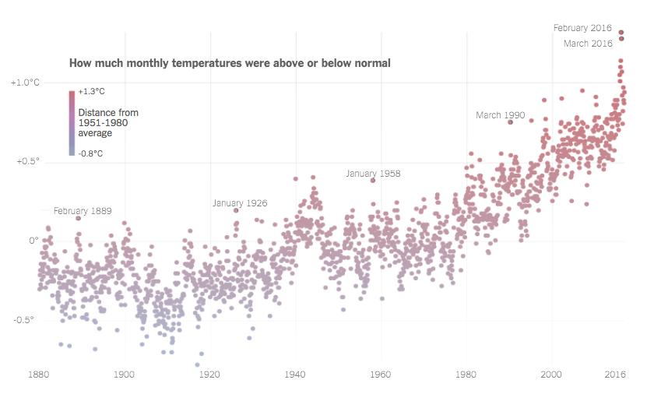
Natural Variability

Slide 62
Observed Trend is not decisively outside of the modeled natural variability
Large natural variability can explain why some models achieve “incorrect” historical trend

Slide 63
Global carbon and heat are negatively correlated across all simulations regardless of Weddell Sea Convection

Slide 65
Positive (negative) correlation between age and oxygen (AOU)
Reduced horizontal variability
and
Vertical offset between age and AOU maximums

Slide 66
Has the SH jet continued to shift?
Can we estimate natural variability from observational (proxy) data?
How would this compare with modeled natural variability?
How does the newest generation of model’s natural variability compare with CMIP5?
Does this negative correlation exist in other climate models?
Is there observational evidence that supports this negative correlation?
What frequency of WS convection is ‘correct’?
Is this anomalous correlation seen elsewhere?
What causes the lower region of anomalous correlation?
What are the implications for estimates of OUR?
Unanswered Questions

Slide 67
Final Thoughts
Importance of Natural Variability
Necessity of Observational Data

Slide 68
Acknowledgements
Advisors: Darryn Waugh and Anand Gnanadesikan
Andrew Chen
All EPS Faculty - Tom Haine & Peter Olsen
Family - Nancy and Bob Thomas
EPS Postdocs & Graduate Students - Eshwan Ramudu, Anna Scott, Grace Kim, Will Seviour, Rolando Saunders.

Slide 69
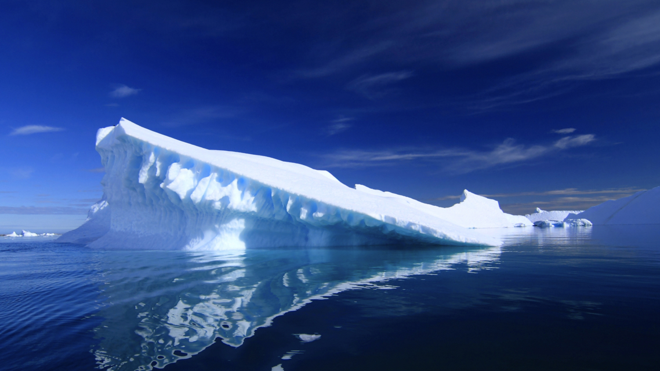
Questions?

Slide 81
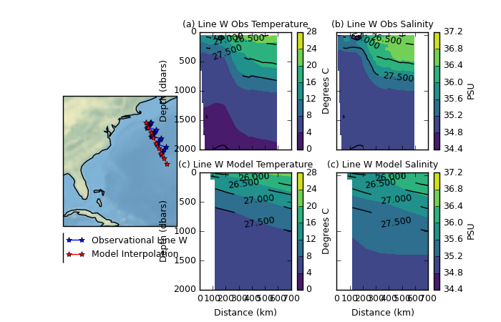

Slide 82
